Slide 1
4-IBFE Tutorial: Fiber Tension Adapted from Alex Hoover

Slide 2
Important Parameters for Material Model
s : Reference configuration of the element
X : Current configuration of the element
F: In tensor notation ∂Xi / ∂sj, the derivative of each component of the deformed X vector with respect to each component of the reference s vector.
http://www.continuummechanics.org/cm/deformationgradient.html
P : First Piola-Kirchhoff Stress Tensor; Expresses the stress relative to the reference configuration. http://en.wikipedia.org/wiki/Piola-Kirchhoff_stress_tensor#Piola.E2.80.93Kirchhoff_stress_tensor
http://www.amazon.com/Nonlinear-Continuum-Mechanics-Element-Analysis/dp/0521838703/ref=sr_1_2?ie=UTF8&qid=1404323260&sr=8-2&keywords=continuum+mechanics+finite+element

Slide 3
Creating a stress function in main.c
void
PK1_dev_stress_function(
TensorValue<double>& PP,
const TensorValue<double>& FF,
const libMesh::Point& /*X*/,
const libMesh::Point& /*s*/,
Elem* const /*elem*/,
const std::vector<const std::vector<double>*>& /*var_data*/,
const std::vector<const std::vector<VectorValue<double> >*>& /*grad_var_data*/,
double /*time*/,
void* /*ctx*/){
}
PP : The First Piola Kirchoff Stress Tensor
FF : Deformation Gradient
X : Current position of the element
s : Reference configuration position

Slide 4
Neo Hookean PK1 Stress
For a Neo-Hookean Material Model, deviatoric component of stress is
P=mu*F
Where mu is our modulus of elasticity. Think of as each node connected to two (in 2D) or three (in 3D) other nodes using a spring. The higher the mu, the stiffer the object.

Slide 5
Neo Hookean deviatoric PK1 Stress
void
PK1_dev_stress_function(
TensorValue<double>& PP,
const TensorValue<double>& FF,
const libMesh::Point& /*X*/,
const libMesh::Point& /*s*/,
Elem* const /*elem*/,
const std::vector<const std::vector<double>*>& /*var_data*/,
const std::vector<const std::vector<VectorValue<double> >*>& /*grad_var_data*/,
double /*time*/,
void* /*ctx*/){
PP=mu*FF;
return;
}

Slide 6
Neo Hookean PK1 Stress
We will also add a term for dilational component of stress, which enforces the incompressibility condition
P=-mu*F^-T
More information here:
http://en.wikipedia.org/wiki/Neo-Hookean_solid#Incompressible_neo-Hookean_material

Slide 7
Neo Hookean dilation PK1 Stress
void
PK1_dil_stress_function(
TensorValue<double>& PP,
const TensorValue<double>& FF,
const libMesh::Point& /*X*/,
const libMesh::Point& /*s*/,
Elem* const /*elem*/,
const std::vector<const std::vector<double>*>& /*var_data*/,
const std::vector<const std::vector<VectorValue<double> >*>& /*grad_var_data*/,
double /*time*/,
void* /*ctx*/){
PP=-mu*tensor_inverse_transpose(FF, NDIM);
return;
}

Slide 8
Registering Stresses
The stress functions (and other body forces) are created in the ModelData namespace (see Example_IBFE_TargetPoints2D). Stress components are additive, so all we need to do is register them in the main routine.
// Configure the IBFE solver.
ib_method_ops->initializeFEEquationSystems();
FEDataManager* fe_data_manager = ib_method_ops->getFEDataManager();
IBFEMethod::PK1StressFcnData active_stress_data(active_stress_function);
IBFEMethod::PK1StressFcnData PK1_dev_stress_data(PK1_dev_stress_function);
IBFEMethod::PK1StressFcnData PK1_dil_stress_data(PK1_dil_stress_function);
PK1_dev_stress_data.quad_order = Utility::string_to_enum<libMeshEnums::Order>(input_db->getStringWithDefault("PK1_DEV_QUAD_ORDER","THIRD"));
PK1_dil_stress_data.quad_order = Utility::string_to_enum<libMeshEnums::Order>(input_db->getStringWithDefault("PK1_DIL_QUAD_ORDER","FIRST"));
ib_method_ops->registerPK1StressFunction(active_stress_data);
ib_method_ops->registerPK1StressFunction(PK1_dev_stress_data);
ib_method_ops->registerPK1StressFunction(PK1_dil_stress_data);

Slide 9
Active Force
Similar to PK1 Stress, you are applying a generalized force directly on the element. This is a lot easier than in the fiber version of IBAMR because you can use positional information from the reference configuration, s. Also, because it is generalized, the forcing function can be anything of your choosing.
static const VectorValue<double> f_0(-1,0);
void
active_stress_function(
TensorValue<double>& PP,
const TensorValue<double>& FF,
const libMesh::Point& X,
const libMesh::Point& s,
Elem* const /*elem*/,
const std::vector<const std::vector<double>*>& /*var_data*/,
const std::vector<const std::vector<VectorValue<double> >*>& /*grad_var_data*/,
double time,
void* /*ctx*/){
double T = 20;
if((time-floor(time))<0.5) {
double J = FF.det();
TensorValue<double> f_f;
outer_product(f_f,f_0,f_0);
PP = J*T*FF*f_f; }
else {
PP.zero();
}}

Slide 10
Target Point Force
In Example_IBFE_TargetPoints2D, I will use the positional data of the s to move my target up and down in time using target points
Note that for our body force function, we want to update F at the end of our function.

Slide 11
//Moves by comparing to reference configuration, s(.)
{ libMesh::Point s_dump;
kappa_s=1e6; //Stiffness constant
if(time<1) {
s_dump(1)=s(1)+.5*time; //y-component
s_dump(0)=s(0); //x-component
}
else if(time<3) {
s_dump(1)=s(1)+.5+.5*(1-time);
s_dump(0)=s(0);
}
else {
s_dump(1)=X(1); //X(.): current configuration
s_dump(0)=X(0);
}
F = kappa_s*(s_dump-X); //usual target point movement
return;
}

Slide 12
Registering your Body Force
Similar to stress functions, you must also register your body force in main routine.
IBFEMethod::PK1StressFcnData active_stress_data(active_stress_function);
ib_method_ops->registerPK1StressFunction(active_stress_data);

Slide 13
Registering your Equation System
When done remember to register your equation system (though should already be in the main file) for your object. You have to do this for each object/mesh.
ib_method_ops->initializeFEEquationSystems();
…..
EquationSystems* equation_systems = fe_data_manager->getEquationSystems();

Slide 14
Examples
Take a look at the following examples for fiber stresses on github under 4-IBFE-Examples-XXXX

Slide 15
Basic Idea
Apply an active tension that plays the role of muscle.
This tension acts in addition to the innate passive elastic tension of the structure due to the material model.

Slide 16
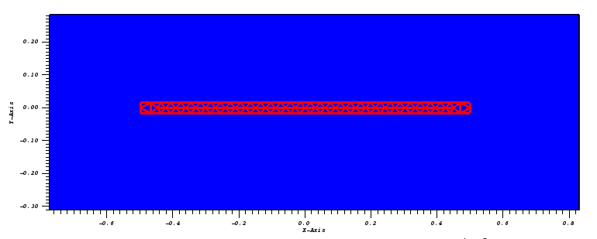
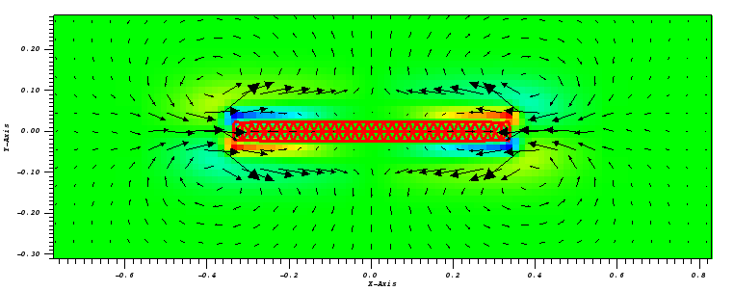
IBFE Fiber Stress 2D Example
This example uses a horizontal beam.
An active tension is applied that contracts the beam for times N<t<N+0.5, where N is an integer.
Otherwise the tension is released.

Slide 17
Active stress function in main.C
static const VectorValue<double> f_0(-1,0);
void
active_stress_function(
TensorValue<double>& PP,
const TensorValue<double>& FF,
const libMesh::Point& X,
const libMesh::Point& s,
Elem* const /*elem*/,
const std::vector<const std::vector<double>*>& /*var_data*/,
const std::vector<const std::vector<VectorValue<double> >*>& /*grad_var_data*/,
double time,
void* /*ctx*/){
double T = 20;
if((time-floor(time))<0.5) {
double J = FF.det();
TensorValue<double> f_f;
outer_product(f_f,f_0,f_0);
PP = J*T*FF*f_f;
}
else {
PP.zero();
}}

Slide 18
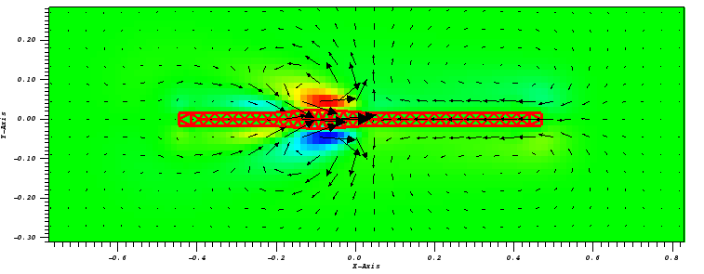
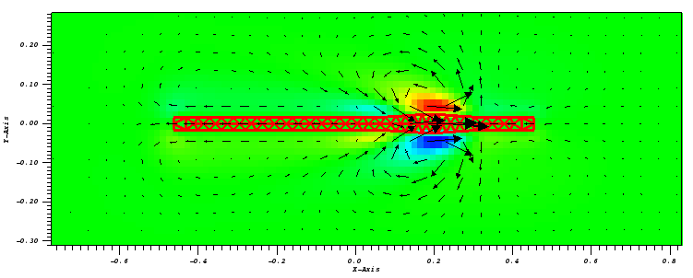
IBFE Moving Fiber Stress Example
This example also uses a horizontal beam.
An active tension is applied to a portion of the beam.
The applied tension translates along the length causing a local region of contraction.

Slide 19
Active stress function in main.C
static const VectorValue<double> f_0(-1,0);
void
active_stress_function(
TensorValue<double>& PP,
const TensorValue<double>& FF,
const libMesh::Point& X,
const libMesh::Point& s,
Elem* const /*elem*/,
const std::vector<const std::vector<double>*>& /*var_data*/,
const std::vector<const std::vector<VectorValue<double> >*>& /*grad_var_data*/,
double time,
void* /*ctx*/){
// T is the magnitude of tension. Varies in space and time. 40 is the maximum.
//This is set up as a traveling Gaussian wave.
// s(0) gives the x-position of the reference configuration.
double t_cycle=time-floor(time);
double T = 40*exp(-(s(0)-(t_cycle-.5))*(s(0)-(t_cycle-.5))/(.1*.1));
double J = FF.det();
TensorValue<double> f_f;
outer_product(f_f,f_0,f_0);
PP = J*T*FF*f_f;
}

Slide 20
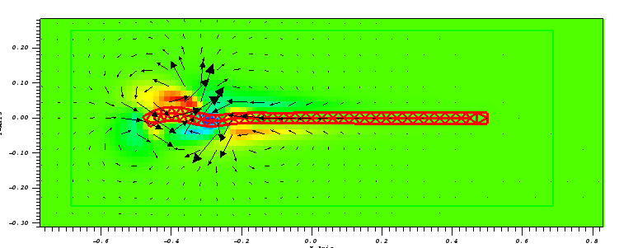
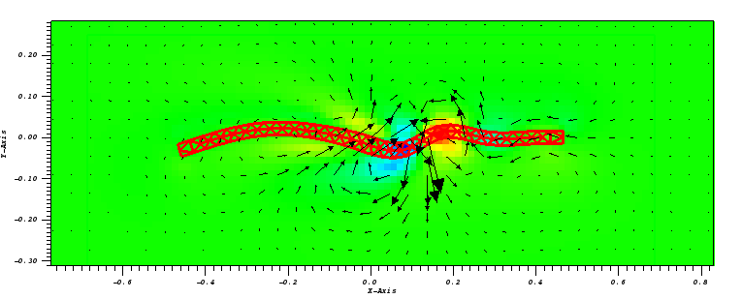
IBFE Alternating Fiber Stress Example
This example also uses a horizontal beam.
An active tension is applied only the the bottom half of beam.
The applied tension translates in the x-direction along the length causing a local region of contraction.

Slide 21
Active stress function in main.C
void active_stress_function(
TensorValue<double>& PP,
const TensorValue<double>& FF,
const libMesh::Point& X,
const libMesh::Point& s,
Elem* const /*elem*/,
const vector<NumericVector<double>*>& /*system_data*/,
double time,
void* /*ctx*/)
{

Slide 22
Active stress function in main.C
//apply tension only to the bottom half of the beam (e.g. check y-position of reference)
if (s(1) < 0) {
double t_cycle = time - floor(time); //Determine time in the cycle.
//Apply tension as traveling Gaussian wave along the x-axis
double T = 30 * exp(-(s(0) - (t_cycle - .5)) * (s(0) - (t_cycle - .5)) / (.1 * .1));
//const TensorValue<double> f_0(1,0);
double J = FF.det();
TensorValue<double> f_f;
outer_product(f_f, f_0, f_0);
PP = J * T * FF * f_f;
}
else { //Set tension on top half to zero
PP.zero();
}
}

Slide 23
Homework
Take example 2 and apply tension as a sine wave that travels down the body. Note that you want to use something like 1.0/2.0* (1.0+sin((2.0*pi*(s(0)/body_length + time))) to not create negative tension.
Squeeze the top and the bottom out of phase using the traveling sine wave (see example 3 for ideas).

